Slide 1
Amazon Customer Reviews Analysis Using AWS

Slide 2
AWS Services Used
S3
Redshift
Secret Manager
Glue
Step Functions
SNS(Simple Notification Service)
QuickSight

Slide 3
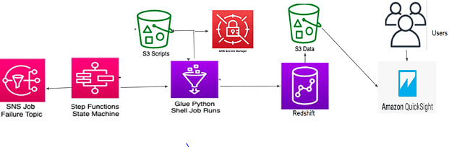
Architecture

Slide 4
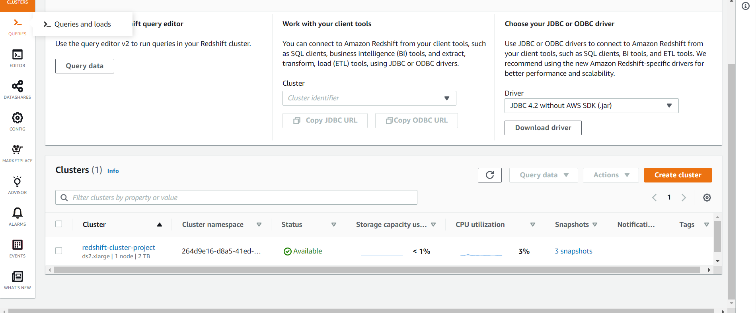
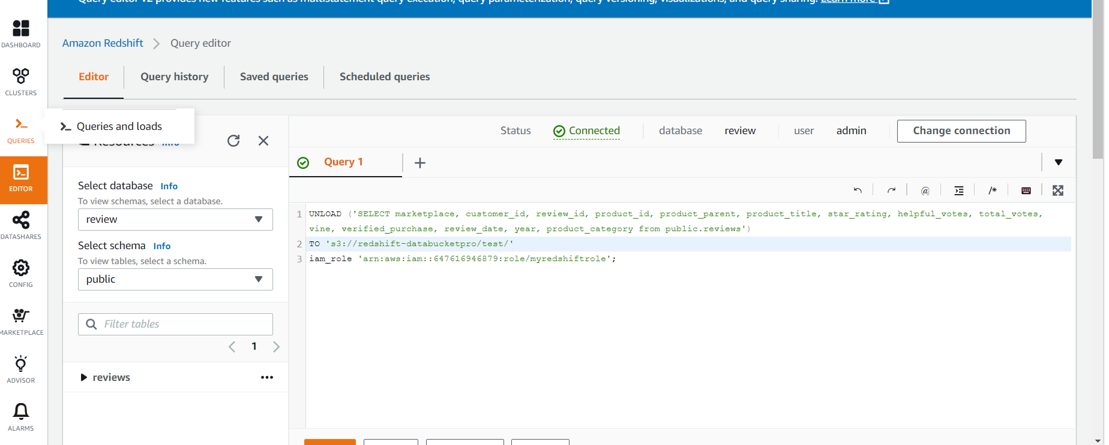
Step 1: Creating Redshift Cluster

Slide 5
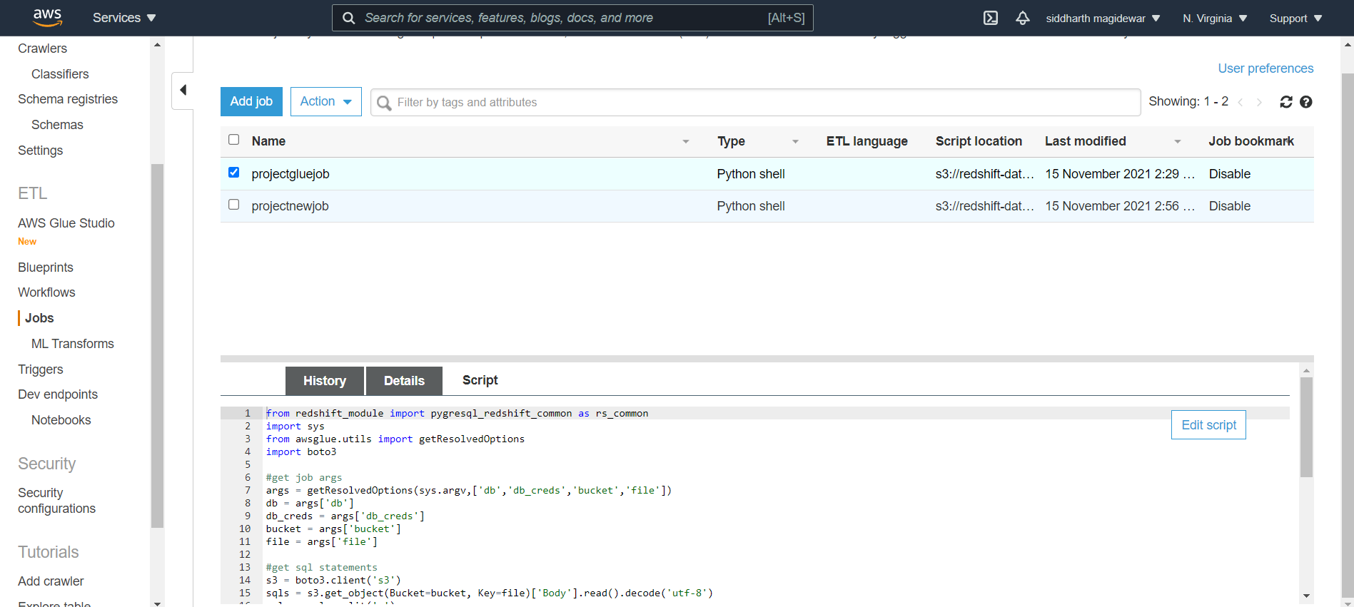
Step 2: Creating Glue Jobs

Slide 6
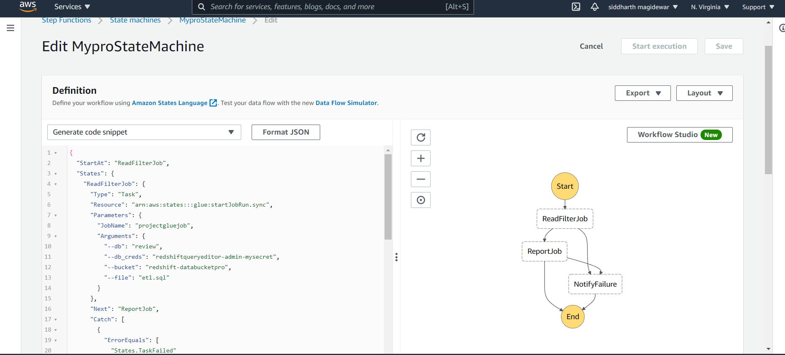
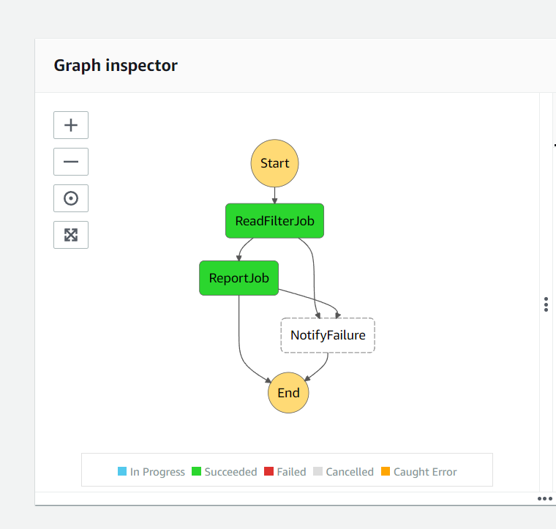
Step 3: Creating Step functions

Slide 7
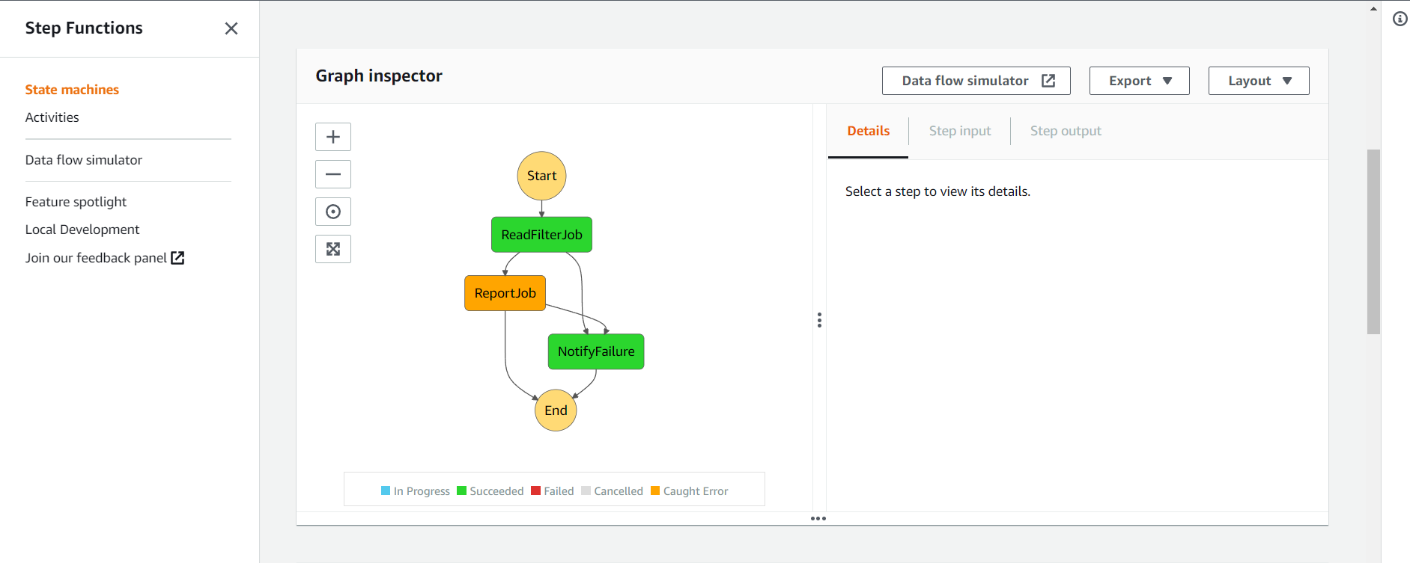

Slide 8
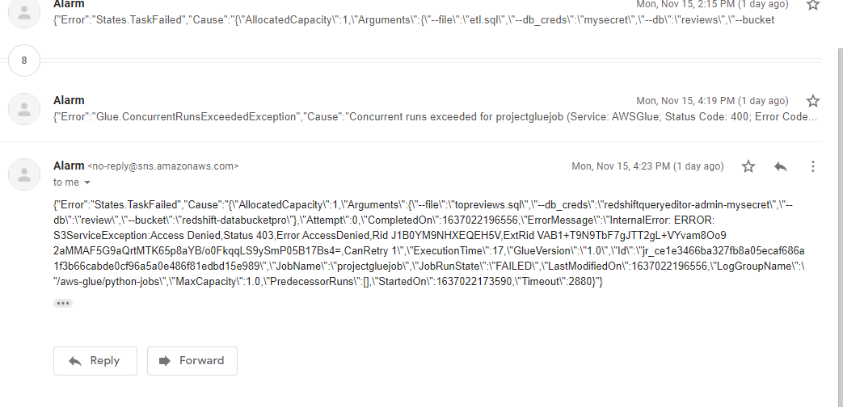

Slide 9
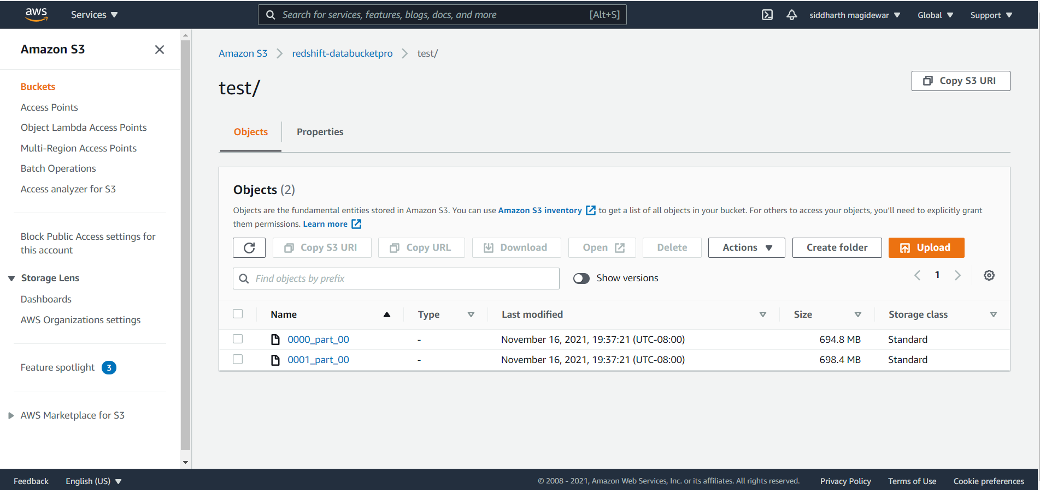
Filtered Data Loaded to S3 bucket

Slide 10
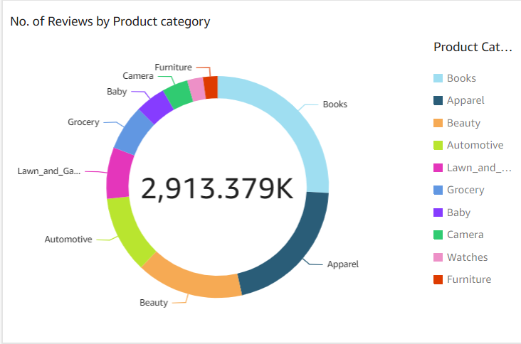
Visualizations

Slide 11
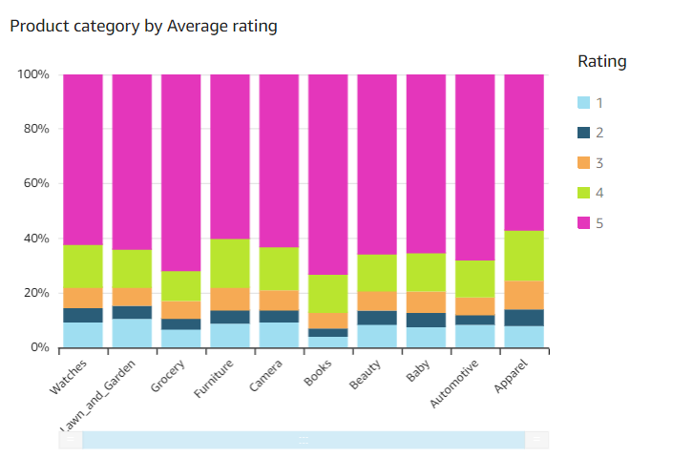

Slide 12
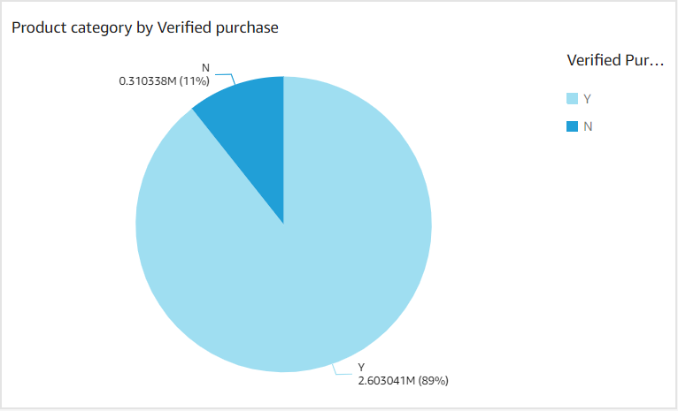

Slide 13
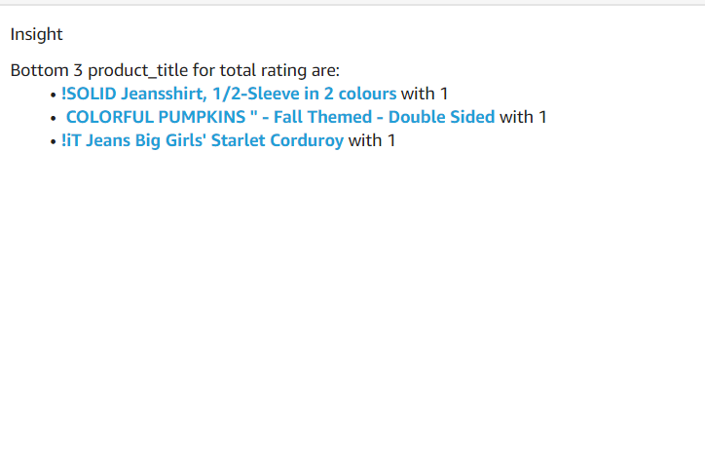

Slide 14
Conclusion
“Make a customer, not a sale.”

Slide 15
THANK YOU

